Slide 1
Presented By: Ashfaq Ahmad (19pwcse1795) Amir suleman (19pwcse1805) Mansoor Hussain (19pwcse1758) Instructor: Ma’am Sumyyea Salahuddin
Query Processing: Joins & Sorting
Database Management Science, Spring 2022, DCSE

Slide 2
Sorting in Database
Arranging values in specific order.
Ascending order .
Descending order
Remove Duplicates.
For fast execution of operation.
For Efficient query processing.
Database Management Science, Spring 2022, DCSE

Slide 3
Types of sorting
Two types of sorting
Internal Sorting
External sorting
Internal sorting is done in main memory.
It may be Quick sorting o bubble sorting.
External Sorting is used when the relation is very large than buffer main memory .
In Database, only external sorting used.
Database Management Science, Spring 2022, DCSE

Slide 4
External Sorting
Use External-merge sort algorithm.
Use Divide and conquer rule.
Steps:
Divide all items of array into two items pairs. If single make single group.
Sort each pair.
Merge two pairs into a single pairs.
Sort the Merge pairs.
Repeat the above step until we get sorted array.
Database Management Science, Spring 2022, DCSE

Slide 5
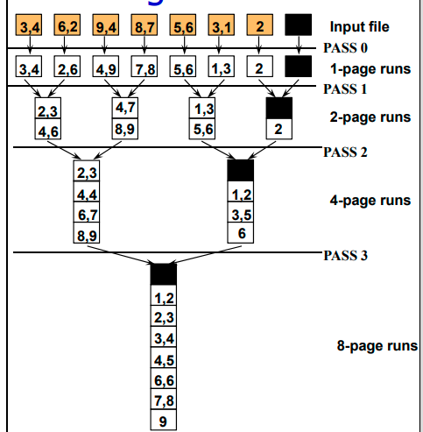
Example
Database Management Science, Spring 2022, DCSE

Slide 6
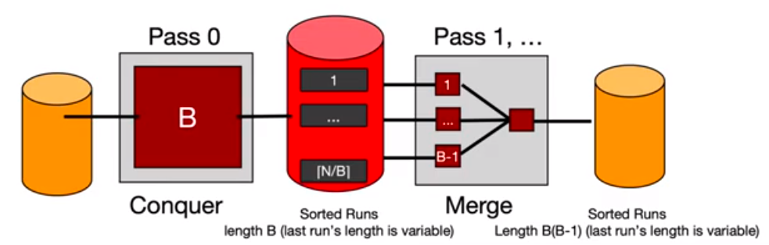
General External Merge Sort
To sort a file with N pages using B buffer pages:
Pass 0: use B buffer pages. Produce sorted runs of B pages each.
Pass 1, 2, …, etc.: merge B-1 runs.
Database Management Science, Spring 2022, DCSE

Slide 7
Cost of External Merge Sort
Number of passes: 1 +[log B-1[N/ B ]]
Cost = 2N * (# of passes).
E.g., with 5 buffer pages, to sort 108 page file:
Pass 0: [108/5]=22 sorted runs of 5 pages each (last run is only 3 pages)
Now, do four-way (B-1) merges
Pass 1: [22/4] = 6 sorted runs of 20 pages each (last run is only 8 pages)
Pass 2: 2 sorted runs, 80 pages and 28 page
Pass 3: Sorted file of 108 pages
Database Management Science, Spring 2022, DCSE

Slide 8
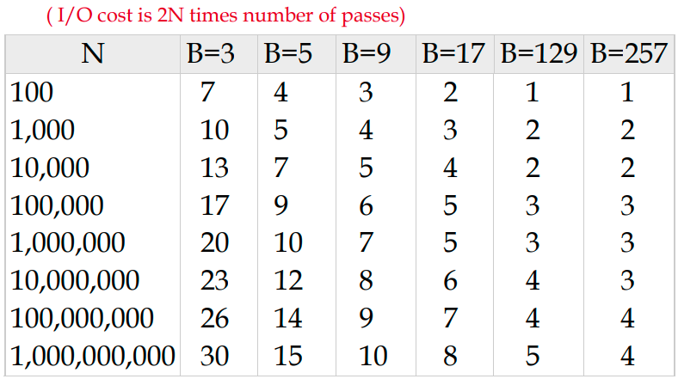
Number of passes of External sort
Database Management Science, Spring 2022, DCSE

Slide 9
Joins
Used for joining Relations.
used when we need data which we can’t access from single table.
Join is Cross product (X) + selection.
For joining two relations, there must be minimum one common attribute in both relation.
Database Management Science, Spring 2022, DCSE

Slide 10
Types of Joins
Cross Join
Natural Join
Conditional Join
Equi Join
Self Join
Outer Join
Left outer join
Right outer join
Full outer join
Database Management Science, Spring 2022, DCSE

Slide 11
Nested loop join
Algorithm for join operation.
Two relations inner(s) and outer (r).
Each tuple (Tr) of outer relation will compare with all tuples(Ts) of inner relation.
Nested loop requires no indices.
Expensive since it examines every pair of tuples in two relations.
Database Management Science, Spring 2022, DCSE

Slide 12
Index Nested Loop Join
In nested loop join, if there is inner index, index lookup can replace file scans.
For each tuple tr in outer relation r, the index is used to look up tuples in s that will satisfy the join condition with tuple tr.
For each tuple in outer relation r, a lookup is performed on the index s and relevant tuples are retrieved.
Database Management Science, Spring 2022, DCSE

Slide 13
Block Nested loop join
In first Two algorithm we are comparing outer(r )and inner(s) relations tuple by tuple.
In this algorithm r and s are compare block by block.
For each block Br of r and Bs of s, each tuple tr in Br compare with each tuple ts in Bs.
One compare finish, another block Br and Bs activate and starts comparing tuple by tuple.
Database Management Science, Spring 2022, DCSE

Slide 14
Sort-Merge join
Used to Compute Natural and Equi Join.
Join two relations which are sorted by common attribute.
Ps and pt are two pointers pointing first tuple of relation.
Read all the tuples pointing by ps
Database Management Science, Spring 2022, DCSE

Slide 15
Hash join
Used to implement Natural and Equi join.
Hash function h is used to partition tuple of both relation.
Partition tuple of each relations into sets that have the same hash values on join attributes.
Database Management Science, Spring 2022, DCSE

Slide 16
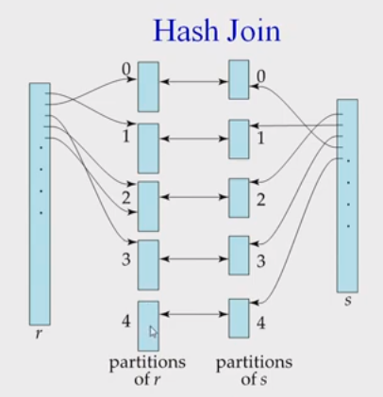
Database Management Science, Spring 2022, DCSE

Slide 17
Hash Join(cont)
If r tuple and s tuple satisfy the join condition then they have same value for join attribute.
If that value is hashed to same value i, the tuple has to be in ri and si.
R tuple in ri need only to be compared with s tuple in si, they don’t need to be compared with s tuple in any other partition.
Database Management Science, Spring 2022, DCSE

Slide 18
Thank you

